Slide 1


Introduction to
Robotic Process Automation
Stock price traker and updater
220701307
Umesh Subramanian S
Guide: Ms. U.Farjana, M.Tech.
Assistant Professor
Department of Computer Science and Engineering

Slide 2
Abstract
This project automates stock price tracking using UiPath Studio, streamlining the process of retrieving, comparing, and recording stock prices. The system extracts real-time data from a financial website at specified intervals, identifies price changes, and updates an Excel report. Additionally, it enhances usability by automatically sending an email with the updated Excel sheet as an attachment to the user, ensuring timely delivery of information. By eliminating manual effort, it improves accuracy and efficiency. Future enhancements, such as API integration and real-time updates, can further expand its functionality, demonstrating the potential of RPA in financial automation.

Slide 3
Need for the Proposed System
The proposed system addresses the need for efficient, accurate, and automated monitoring of stock prices. In the fast-paced financial environment, manual tracking of stock prices is time-consuming, prone to errors, and lacks the timeliness required for making informed decisions. The integration of automation not only ensures real-time data retrieval and processing but also minimizes the risk of human error. Furthermore, the inclusion of an automated email feature enhances usability by delivering updated stock reports directly to the user, eliminating the need for manual file access. This system is especially beneficial for financial analysts, traders, and individual investors who require up-to-date information to respond promptly to market changes, thereby improving decision-making and productivity.

Slide 4
Advantages of the Proposed System
The proposed system offers a range of advantages by combining automation, real-time data extraction, and email integration. It eliminates the need for manual stock price monitoring, ensuring faster and more accurate data retrieval. The system efficiently updates stock prices at regular intervals and generates a well-structured Excel report for easy analysis. With the added functionality of emailing the updated report to the user, it enhances accessibility, allowing users to receive critical updates directly in their inbox. This feature ensures timely decision-making without requiring constant monitoring of the system. Additionally, the scalability of the solution enables it to handle multiple stocks and recipients, making it suitable for both personal and professional use. Overall, the system improves productivity, reliability, and convenience in financial data management.

Slide 5
Literature Survey
Web Scraping Techniques and Applications: A Literature Review
Source: "Web Scraping as a Tool for Real-Time Data Acquisition in Finance" (Myriam ertz & Imen latrouz, 2021).
The authors discuss the role of web scraping in extracting stock prices and other market data. The paper outlines methods to implement dynamic web scraping using tools like Selenium, which aligns closely with UiPath’s capabilities.
Advantages: Access to real-time data and ease of integration with analytics systems.
Disadvantages: Susceptibility to changes in website structure, which may disrupt automation workflows.

Slide 6
Main Objective
The primary objective of this project is to automate the process of stock price monitoring, comparison, and reporting using UiPath Studio. The system aims to eliminate manual effort by dynamically extracting stock prices from a financial website at specified intervals, analyzing the changes, and updating the results in an Excel spreadsheet. Additionally, the project enhances user accessibility by automating the email delivery of the updated Excel report, ensuring timely and convenient access to the data. This solution is designed to improve efficiency, accuracy, and usability in financial data management, providing a reliable and scalable tool for both personal and professional applications.

Slide 7
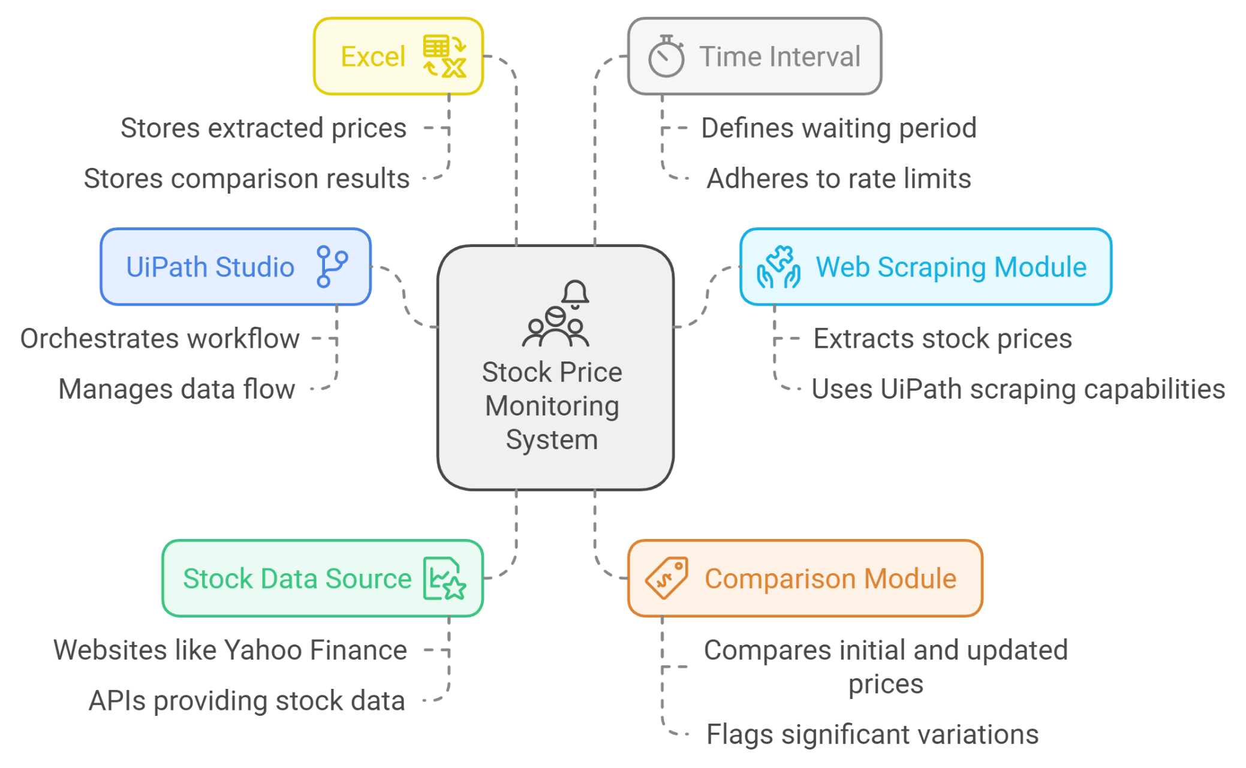
Architecture

Slide 8
System Requirements
Software Requirements
Operating System:
Windows 10 or later (64-bit recommended).
Compatible with UiPath Studio system requirements.
UiPath Studio:
Latest stable version of UiPath Studio for development and execution.
Required packages for activities like web scraping, Excel operations, and email automation.
Microsoft Excel:
Excel 2016 or later for spreadsheet creation and manipulation.
SMTP Server Configuration:
Access to an email service provider supporting SMTP (e.g., Gmail, Outlook).
Relevant SMTP credentials (e.g., server address, port, email ID, and password).
Web Browser:
Google Chrome, Mozilla Firefox, or Microsoft Edge with UiPath browser extension installed for web scraping

Slide 9
System Requirements
Hardware Requirements
Processor:
Minimum: Dual-Core Processor.
Recommended: Quad-Core Processor or higher for faster performance.
RAM:
Minimum: 4 GB.
Recommended: 8 GB or higher for smooth operation, especially when handling large datasets or multiple workflows.
Storage:
Minimum: 10 GB free disk space.
Recommended: SSD with 20 GB or more free space for faster file handling and workflow execution.
Internet Connection:
Stable connection for accessing online resources, retrieving stock prices, and sending emails.

Slide 10
Functional Description
Stock Price Retrieval:
The system uses web scraping techniques to extract real-time stock prices from a financial website. It leverages UiPath’s web automation activities to navigate the site and dynamically retrieve the required data based on user-defined criteria.
Data Comparison:
After retrieving stock prices at a specified interval, the system compares the new data with previously recorded values. Any changes in stock prices are identified and flagged for further analysis.
Excel Report Generation:
The updated stock prices, along with their comparisons, are recorded in an Excel spreadsheet. This report is structured for clarity, containing columns for stock names, initial prices, updated prices, and percentage changes.
Automated Email Delivery:
Once the Excel report is updated, the system automatically sends the file to the user’s email address using the Send SMTP Mail Message activity. The email contains the updated report as an attachment, ensuring timely delivery of data.
Error Handling:
The system incorporates robust error-handling mechanisms to ensure reliability. It handles scenarios such as website changes, network interruptions, or invalid email configurations by logging errors and providing alerts for troubleshooting.
User Interaction and Scheduling:
The system requires minimal user interaction. It can be configured to run at specified intervals, automating the entire process from data retrieval to email delivery. Users can set parameters like the stock list, time intervals, and recipient email addresses.

Slide 11
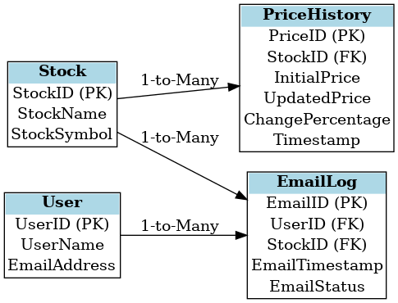
Table Design

Slide 12
Process Design
Main Process
Initialization:
Load configuration settings (e.g., stock list, website URL, email recipient details).
Set the desired interval for stock price retrieval (e.g., every hour).
Prepare the environment for the web scraping and email sending operations.
Stock Price Extraction:
Trigger the Stock Price Retrieval Subprocess to extract the latest stock prices from the specified financial website.
Ensure that the system logs the timestamps of when the prices were fetched for tracking purposes.
Data Comparison:
Compare the newly extracted stock prices with the previously recorded prices in the PriceHistory table.
Calculate the percentage change and store the updated information.
Excel Report Update:
Trigger the Report Generation Subprocess to update the Excel file with the new stock prices and comparisons.
Ensure that the file format remains consistent for readability.
Email Notification:
Trigger the Email Sending Subprocess to email the updated Excel file to the designated recipients.
Ensure that email status is logged for record-keeping purposes.
Completion:
Log the completion of the process, including timestamps and system status.
Wait for the next scheduled interval and repeat the process.
Sub Process

Slide 13
Process Design
Sub Process
1. Stock Price Retrieval Subprocess
This subprocess is responsible for accessing the financial website and extracting real-time stock prices. It uses web scraping techniques to navigate the webpage, locate the stock price elements, and retrieve the required data.
Inputs: URL of the financial website, stock symbols.
Outputs: Extracted stock prices.
Steps:
Access the website using an automated browser.
Locate and extract the stock price data.
Return the stock prices to the main process.
2. Report Generation Subprocess
The Report Generation Subprocess updates the Excel file with the new stock prices and calculated changes.
Inputs: Extracted stock prices, comparison data (percentage change), Excel file.
Outputs: Updated Excel file.
Steps:
Open the Excel file and check for existing data.
Insert new data, including stock name, initial price, updated price, and percentage change.
Save and close the Excel file.
3. Email Sending Subprocess
This subprocess handles the task of sending the updated Excel report via email. It uses SMTP protocol to send the email with the attached Excel file to the specified recipient(s).
Inputs: User email addresses, updated Excel file.
Outputs: Sent email (confirmation or failure log).
Steps:
Compose the email with the attached Excel file.
Send the email using SMTP configuration.
Log the email status (whether it was sent successfully or encountered an error).

Slide 14
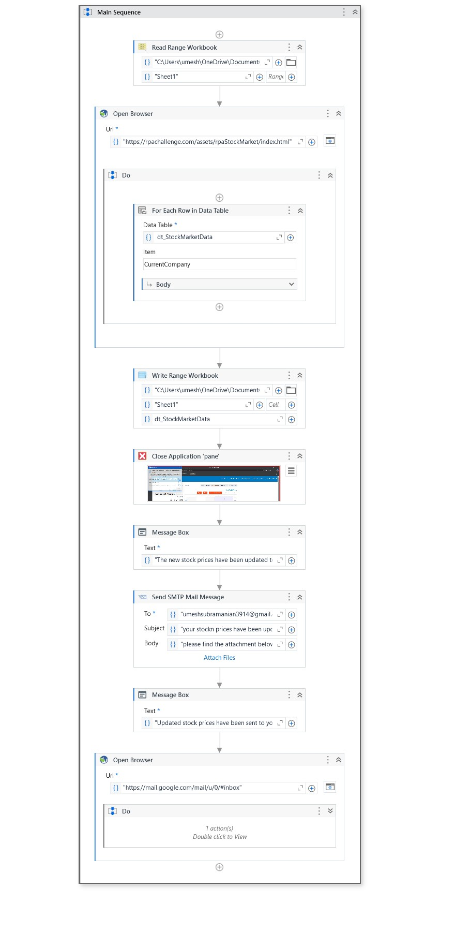
Implementation

Slide 15
Testing
Testing for the stock price monitoring system involves verifying that each component functions correctly and that the system as a whole meets the project requirements. The testing process includes the following steps:
Unit Testing:
  Each subprocess (e.g., stock price retrieval, Excel report generation, email sending) is tested individually to ensure it operates as expected.
Integration Testing:
  The individual subprocesses are integrated, and their interaction is tested to ensure smooth data flow and correct execution (e.g., comparing stock prices, updating the Excel file, and sending emails).
System Testing:
  The complete system is tested under different conditions (e.g., different stock symbols, time intervals) to ensure it runs correctly end-to-end.

Slide 16
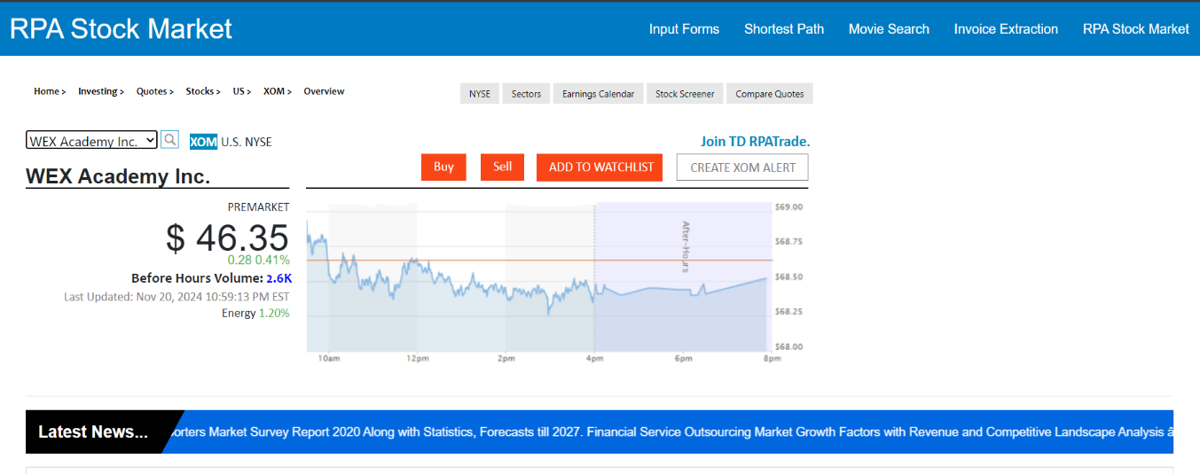
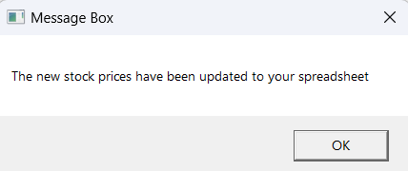
Testing

Slide 17
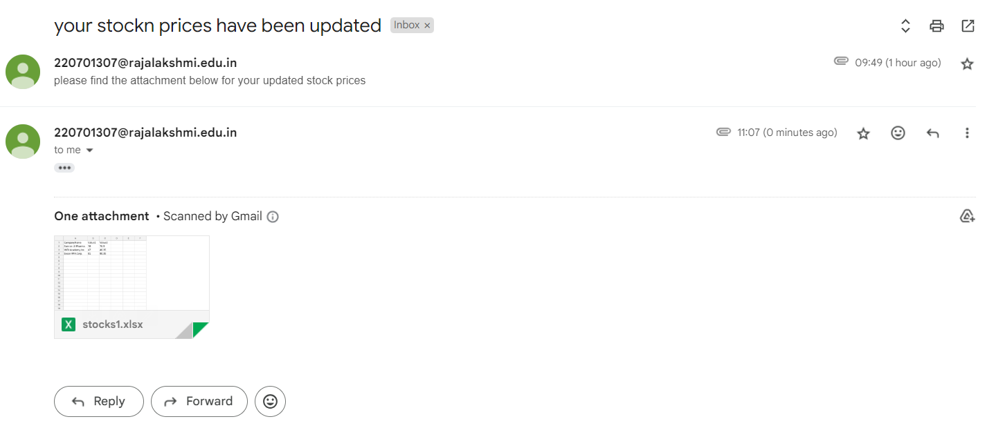

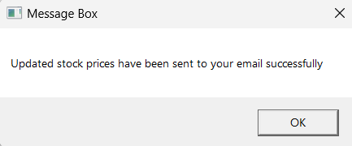
Testing

Slide 18
Conclusions
The stock price monitoring and reporting system developed in this project offers an efficient and automated solution to track real-time stock price changes, perform data comparisons, and generate periodic reports. By leveraging UiPath Studio’s capabilities for web scraping, Excel automation, and email notification, the system ensures timely and accurate updates for users, reducing the need for manual interventions and improving productivity.
Key accomplishments of the project include:
Automation of the process to extract, compare, and store stock prices at regular intervals.
The generation of comprehensive reports in Excel format, making it easier for users to analyze price trends.
Seamless email integration, allowing the system to send updated stock price reports to users automatically.
The system was successfully implemented with robust error handling, making it resilient to potential failures such as website changes or email sending issues. It also provides an easy-to-use platform that can be scaled to monitor more stocks, providing further value to users.
In conclusion, this project fulfills its objectives of automating stock price monitoring and reporting, ensuring that users stay informed with minimal effort. The successful integration of all components, coupled with the flexibility and scalability of the solution, makes it a valuable tool for any individual or organization requiring regular stock price updates.

Slide 19
Future Enhancement
While the current stock price monitoring system is functional, several enhancements could be made to improve its capabilities and user experience:
Real-Time Price Alerts:
Allow users to set price thresholds for automatic notifications when stock prices reach certain levels, enabling more proactive monitoring.
Multiple Stock Market Platform Integration:
Expand the system to gather data from multiple financial platforms, ensuring more reliable and comprehensive stock price information.
Historical Data Analysis and Visualization:
Integrate tools for analyzing historical stock trends and generating visual reports (charts/graphs), providing users with deeper insights into stock performance.
Enhanced Error Handling:
Improve error handling with automatic retries, detailed logging, and fallback mechanisms to ensure smoother operation even in case of issues.
User Customization:
Allow users to add/remove stocks from the monitoring list and set personalized report formats and frequencies for more flexibility.
Support for Multiple Email Recipients:
Enable the system to send reports to multiple recipients, facilitating sharing among teams or clients.
Financial API Integration:
Integrate third-party APIs (like Alpha Vantage) to retrieve real-time stock prices more accurately and quickly.
Mobile Notifications:
Extend notifications to mobile devices, keeping users informed on the go with stock price updates and alerts.
Cloud Deployment:
Migrate the system to the cloud for improved scalability, reliability, and remote access.
Machine Learning for Predictive Analytics:
Implement predictive models to forecast future stock price movements based on historical data and trends.
These enhancements would increase the system's functionality, scalability, and user engagement, making it a more comprehensive tool for stock price monitoring.

Slide 20
IEEE Paper
Intelligent Automation in Stock Market Prediction: A Survey of Automated Models
Authors: Anirudhan Adukkathayar C; Vishwanath R Hulipalled; Jay Bharthish Simha; Ramesh Chundi
Stock Market Manipulation Detection using Artificial Intelligence: A Concise Review
Authors:Mohd Asyraf Zulkifley; Mohd Edil Abd Sukor; Ali Fayyaz Munir; Muhammad Hakimi Mohd Shafiai

Slide 21
References

Slide 22
Queries

Slide 23
Demonstration

Slide 24
Thank You

